Slide 1
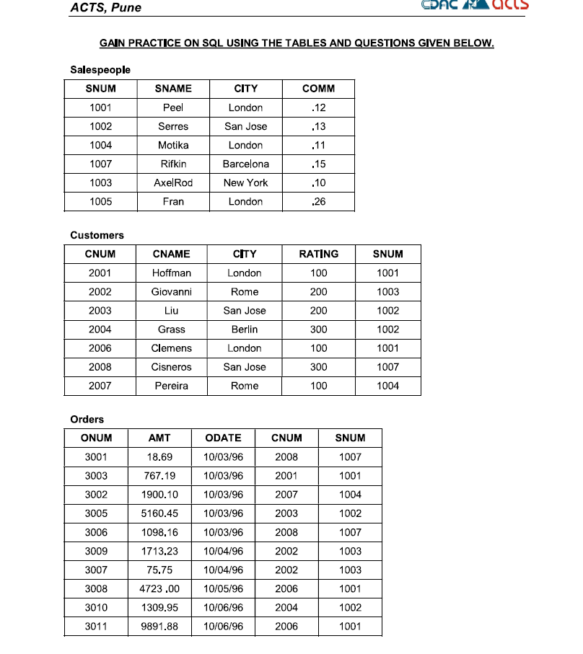
SNUM IS NAME AS idSNUM IN MY TABLE.
Salespeople Table
CREATE TABLE Salespeople (
SNUM INT PRIMARY KEY,
SNAME VARCHAR(50),
CITY VARCHAR(50),
COMM DECIMAL(4,2));
Customers Table
CREATE TABLE Customers (
CNUM INT PRIMARY KEY,
CNAME VARCHAR(50),
CITY VARCHAR(50),
RATING INT,
SNUM INT,
FOREIGN KEY (SNUM) REFERENCES Salespeople(SNUM));
Orders Table
CREATE TABLE
Orders (ONUM INT PRIMARY KEY,
AMT DECIMAL(10,2),
ODATE DATE, CNUM INT,
SNUM INT,
FOREIGN KEY (CNUM) REFERENCES Customers(CNUM), FOREIGN KEY (SNUM) REFERENCES Salespeople(SNUM));

Slide 2
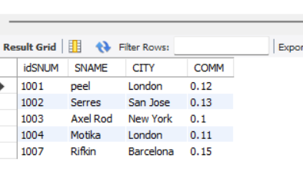
--6. Find which salespeople currently have orders in the Orders table
SELECT DISTINCT s.idSNUM, s.SNAME, s.CITY, s.COMM FROM
Salespeople s JOIN Orders o ON s.idSNUM = o.idSNUM;

Slide 3
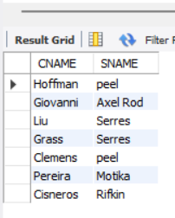
-- 7. List names of all customers matched with the salespeople serving them
SELECT Customers.CNAME, Salespeople.SNAME FROM Customers JOIN Salespeople ON Customers.idSNUM = Salespeople.idSNUM;

Slide 4
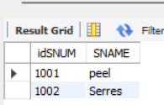
-- 8. Find the names and numbers of all salespeople who had more than one customer
SELECT s.idSNUM, s.SNAME FROM Salespeople s
JOIN Customers c ON s.idSNUM = c.idSNUM GROUP BY s.idSNUM, s.SNAME
HAVING COUNT(DISTINCT c.idCNUM) > 1;

Slide 5
-- 9. Count the orders of each of the salespeople and output the results in descending order
SELECT s.idSNUM, s.SNAME, COUNT(o.idONUM) AS OrderCount
FROM Salespeople s JOIN Orders o ON s.idSNUM = o.idSNUM
GROUP BY s.idSNUM, s.SNAME ORDER BY OrderCount DESC;

Slide 6
Count the orders of each of the salespeople and output the results in descending order
SELECT s.idSNUM, s.SNAME, COUNT(o.idONUM) AS OrderCount
FROM Salespeople s JOIN Orders o ON s.idSNUM = o.idSNUM
GROUP BY s.idSNUM, s.SNAME ORDER BY OrderCount DESC;

Slide 7
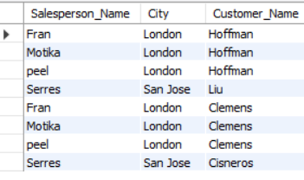
-- 11. Match salespeople to customers according to the city they lived in
SELECT
s.sname AS Salesperson_Name,
s.city AS City,
c.cname AS Customer_Name
FROM
Salespeople s
JOIN
Customers c ON s.city = c.city;

Slide 8

-- 15. List all the orders of salesperson Motika from the Orders table
SELECT o.*
FROM Orders o
JOIN Salespeople s ON o.idsnum = s.idsnum
WHERE s.sname = 'Motika';

Slide 9
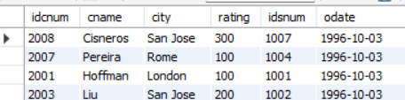
-- 16. Find all customers with orders on October 3
SELECT DISTINCT c.*, o.odate
FROM Customers c
JOIN Orders o ON c.idcnum = o.idcnum
WHERE o.odate = '1996/10/03';
SELECT DISTINCT c.*, o.odate
FROM Customers c
JOIN Orders o ON c.idcnum = o.idcnum
WHERE MONTH(odate) ='10' and day(odate)='3';

Slide 10
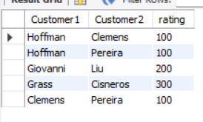
-- 20. Find all pairs of customers having the same rating
SELECT
c1.cname AS Customer1,
c2.cname AS Customer2,
c1.rating
FROM
Customers c1
JOIN
Customers c2 ON c1.rating = c2.rating AND c1.idcnum < c2.idcnum;

Slide 11
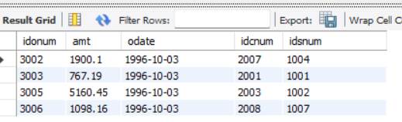
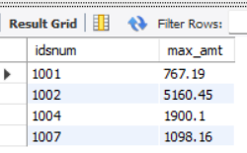
-- 24. List the largest orders for October 3, for each salesperson
SELECT o.*
FROM Orders o
JOIN (
SELECT idsnum, MAX(amt) AS max_amt
FROM Orders
WHERE odate = '1996/10/03'
GROUP BY idsnum
) AS max_orders
ON o.idsnum = max_orders.idsnum AND o.amt = max_orders.max_amt
WHERE o.odate ='1996/10/03';
max_orders

Slide 12
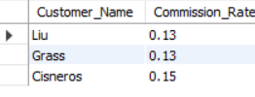
-- 28. Write a query that produces all customers serviced by salespeople with a commission above 12%. Output the customer's name and the salesperson's rate of commission.
SELECT
c.cname AS Customer_Name,
s.comm AS Commission_Rate
FROM
Customers c
JOIN
Salespeople s ON c.idsnum = s.idsnum
WHERE
s.comm > 0.12;

